Slide 1
CSU Travel Policy Location Based Per Diem
Notes:
Good morning. Thank you for joining today’s training on the CSU Travel Policy. We will begin shortly.
We will be recording today’s session so please accept the notification when it displays.
Introductions.
We will begin by talking about the policy change from actuals to location based per diem.
This training is developed to help you implement and train the SDSU campus to make the switch on January 1, 2024.
You may have noticed the policy has not been published yet. The policy is ready to post and will be available just before we go live on 1/1/24.

Slide 2
Learning Objectives
Why Move from “Actuals” to Per Diem
When to Implement the Policy
What is the Per Diem Coverage
Appendices and Examples
Campus Actions
Resources
Questions and Answers
Concur: Implementing Per Diem within the Systemwide Instance
Notes:
The objectives today are:
Our goal if for you to gain an understanding of
Why the CSU has moved from actuals to per diem
When campuses need to implement the policy changes
What are per diem rates and how to best work with them
Scenarios to help you train (which are found in the Appendices of the policy)
Frequently asked questions we’ve had regarding the policy
We’ll provide you some resources to use on your campus

Slide 3
Why Move to Per Diem
Eliminate receipts
Comply with federal guideline
Avoid tax implications
Notes:
Why move from actual receipts to location based per diem?
A workgroup was formed consisting of six campuses (3 associate VPs ,3 VPs), plus the Chancellor’s office.
Their charge was to reduce the administrative burden for processing travel campus-wide by reducing or eliminating the need for receipts.
The agreed upon solution was to move to location-based per diem.
This is because using location-based per diem complies with federal guidelines and avoids tax implications.

Slide 4
Policy Implementation
Available via CSU Policy Library (policystat).
Policy must be implemented on 1/1/2024.
Campus travel policy may apply a more restrictive per diem value than CSU Policy.
Actuals cannot be used for M&IE as it conflicts with CSU Policy.
Notes:
The CSU policy, while not yet published, will be available on CSU Policy Library. The link to the library is provided on this slide.
Campuses must implement the location-based per diem policy January 1, 2024. This means any travel that occurs on or after January 1st will follow the per diem meal payment and any travel prior to 1/1/24 will follow the legacy (non per diem) policy.
One of those restrictions could be you only allow the lowest per diem for non-employees.

Slide 5
What is the Per Diem Coverage
Continental United States (CONUS)
Domestic Meals and Incidental Expenses (M&IE). U.S. General Services Administration (GSA).
Outside the Continental United States (OCONUS)
Alaska, Hawaii, and US territories. US Department of Defense.
International Meals and Incidentals. U.S. Department of State.
Notes:
The per diem rates are as follows:
For domestic or continental United States, the meals and incidental expense rates are set by the General Services Administration (referred to as GSA)
For AK, HI, US territories or international values, the process is consistent with the existing policy, however, to simplify calculations, first and last day across the board is calculated at 75% of the per diem.
For Alaska, Hawaii, and US territories, the rates are set by the department of defense
For international travel meals and incidental expenses, the rates are set by the state department
As you see, links to each of these organizations are provided on this slide. Note that there are lookups for the continental United States on the DoD site, but

Slide 6
What is the Per Diem Coverage (cont.)
Rates refresh (anticipated schedule)
GSA (US) – Annually, beginning of every fiscal year on 10/01
Dept of Defense (DoD) – Monthly
US State Dept (Int’l) – Monthly
Notes:
Rates are refreshed on a scheduled basis.
GSA refreshes its rates annually, at the beginning of their fiscal year (which begins in October).
Both department of defense and department of state refresh their rates monthly. (DoD meals are typically updated annually in October but they may have other updates as necessary. They show monthly amounts in a lookup)
Be sure to stay current with the refresh schedule for the system you have in place. (n/a for Concur campuses)
Hotel is not part of the meals and incidental expense per diem rates. It will continue at the maximum nightly rate of $275 before taxes and fees. Receipts are required for lodging.

Slide 7
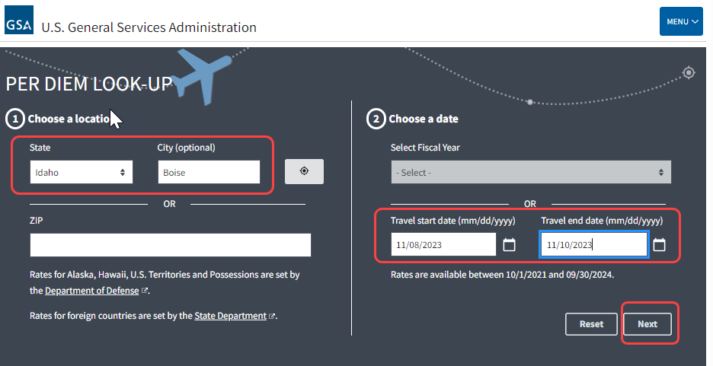
GSA (domestic/CONUS)
Notes:
Let’s look at how to find a per diem rate. The best way to get a targeted domestic per diem rate is to fill in the location (state & city), travel start date and travel end date, then select “Next”.

Slide 8
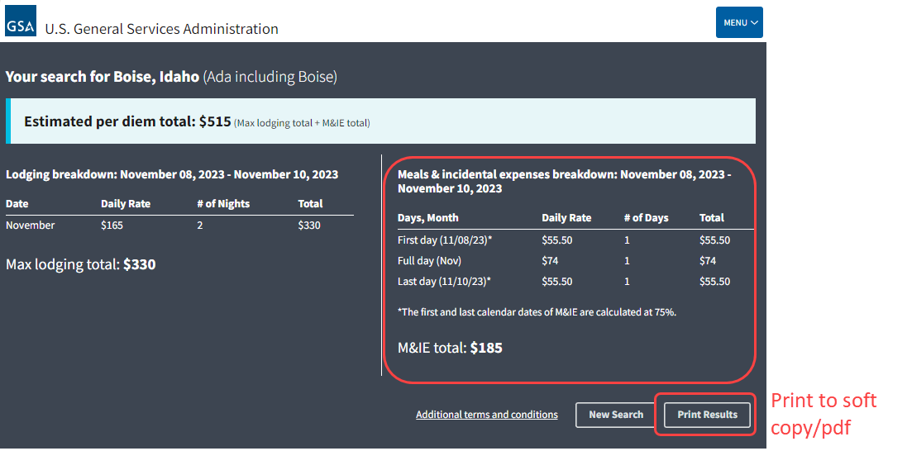
GSA (domestic/CONUS)
Notes:
The specific breakdown for Per Diem displays. While the lodging is visible, we are only following Meals & Incidental Expenses, so we focus on the right side of the window. If you system is not automated, I’d encourage the user to print the results to PDF and attach it to the request for easy reference.

Slide 9
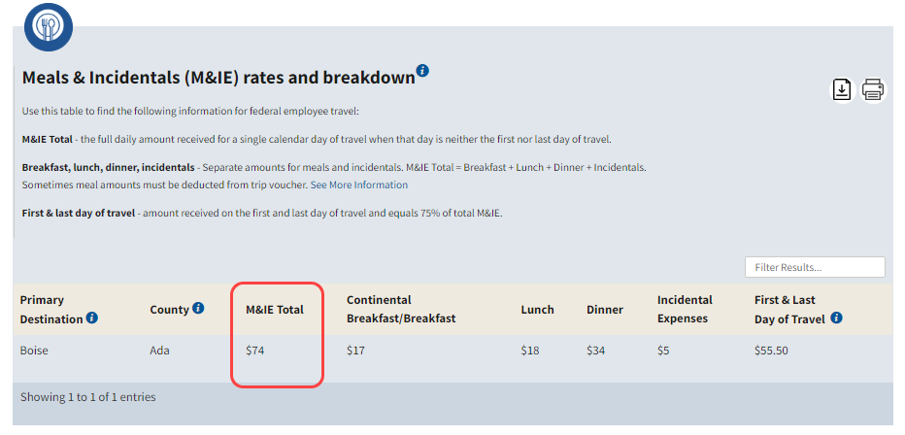
GSA (domestic/CONUS)
Notes:
IF the user selects the year in the drop-down menu, then a more generic view similar to this image will display.

Slide 10
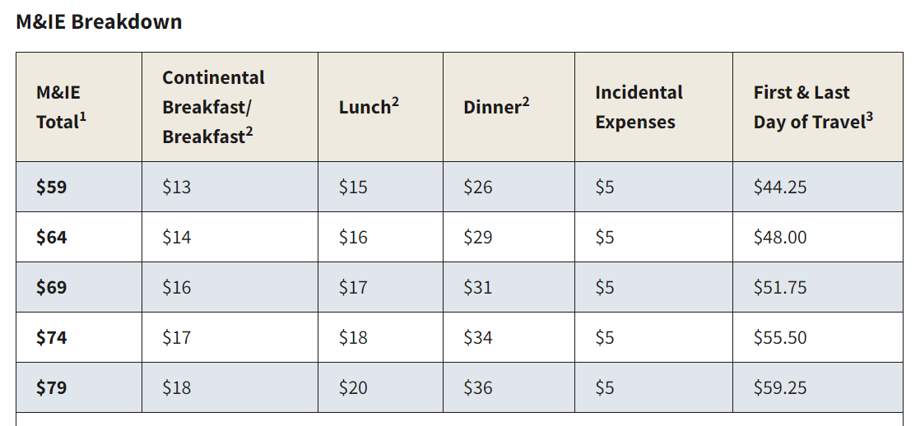
GSA M&IE Breakdown
5 ranges for domestic locations
GSA M&IE breakdown
Ranges shown from $59-$79 ($54-$74 without incidentals).
Displays first and last day of travel (up to 75% of entire day).
Use chart as guide to deduct provided meals.
Notes:
To better understand GSA domestic rates, since that will likely cover the majority of travel destinations, we will refer to this table.
The domestic meals ranges from $59-$79 daily (inclusive of $5 incidental expense).
The numbers on the columns denote:
¹ This column lists the full daily amount employee receive for a single calendar day of travel when that day is neither the first nor last day of travel.
² The separate amounts for breakfast, lunch and dinner listed in the chart are provided should you need to deduct any of those meals from your trip. For example, if your trip includes meals that are already paid for by the conference (such as through a registration fee for a conference), you will need to deduct the full amount of those meals from your claim.
³ This column lists the amount employees receive for the first and last calendar day of travel. The first and last calendar day of travel per diem is calculated at 75 percent. (not the meals)
We have developed a worksheet to help facilitate the breakdown for your end users.

Slide 11
Travel Worksheet
Incorporates deductions for meals.
Keeping it simple
Easy-to-use instructions.
Drop-down fields.
Links to support policy.
Updates to baseline version.
GSA rate change (typically October).
Notes:
The travel worksheet was initially created to assist in calculating partial day per diem. To streamline further, we decided to add other key columns such as airfare, car rental, ground transportation, and advances.
Once the non-employee completes the form, the expenses are totaled by category and by the amount due to traveler.
We envision this tool as a resource for campuses to use to facilitate travel claims for non-employee submissions or for auxiliary employees not currently supported by the Concur system.
Goals
Keep the process and form design as simple as possible.
Minimize campus development time and need for maintenance.
Enable campuses to personalize/brand the worksheet or simply use the baseline version.
Maintenance
The baseline version will be updated as necessary for mileage rates changes, which often occur in January, and GSA rate changes which typically occur in October. The rates for outside the continental US per diem are updated monthly however the worksheet uses the value as supplied by the traveler so there is no need to for worksheet updates.
TRIVIA: The first person to accurately respond in chat will have a Starbucks gift card emailed to them after this training, so everybody get ready to type… Define the acronym CONUS
THE CONTINENTAL UNITED STATES

Slide 12
Define the following acronym: CONUS
CONtinental United States
Notes:
*TRIVIA: The first person to accurately respond in chat will have a Starbucks gift card emailed to them after this training. Everybody get ready to type… Define the acronym CONUS
CONTINENTAL UNITED STATES

Slide 13
Tips (Appendix C)
Meals & Incidental Expenses
Tips and gratuity to hotel staff
Tips for meals
Not Incidental Expenses:
Tips for taxi or shuttle service (transportation)
Tips for valet parking (parking expense)
Notes:
Tips to hotel staff such as bell hops, housekeeping or tips given to waiters and waitresses are included in the location based per diem meals and incidental expenses.
However, tips to taxi drivers or shuttle services are part of transportation expense.
Tips given to valet parking are part of parking fee.

Slide 14
Grants/Sponsored Programs
Sponsors, in general, will accept university processes for travel (in CSU’s case, per diem).
Per Diem rates are widely accepted.
For more restrictive grants/contracts, Sponsored Programs office must have contingency for communicating additional documentation requirements to the Principal Investigator (PI).
Notes:
In most cases, grants will accept the CSU policy. In rare instances, it may be more restrictive, like requiring expenses to be substantiated. The grant office should do its best during review of the grant prior to acceptance to convince the granter that the CSU policy is in compliance with the federal government, especially if it’s a federal grant. However, if the sponsor office accepts the more restrictive requirement, then it needs to comply with its requirement.

Slide 15
M&IE Reimbursement Limits (Appendix E)
Less than 24 hours –
no reimbursement
Less than 24 hours with overnight stay –
75% of location based per diem rate
Notes:
No reimbursement will be paid for travel that is less than 24 hours.
For travel that is less than 24 hours with overnight stay, the meals and incidentals are reimbursed at 75% of the per diem rate
Refer to appendix for travel over 24 hours.

Slide 16
Overnight Example 1
Example: An employee is required to travel from Milwaukee to Madison to work on a project. The employee leaves home at 11:00 a.m. on Monday, with plans to return home the same day. Unable to complete the project on Monday, the employee spends the night in Madison. After completing the project the next day, the employee returns to Milwaukee by 10:30 a.m.
Did the employee meet the overnight test?
Notes:
Read the example.
Yes. Even though the employee had not planned to spend the night and is gone for less than 24 hours, the “away from home” rule was met because the traveler spent the night away from residence on business.

Slide 17
Overnight Example 2
Example: An employee is required to travel from Dallas to Austin to work for the day. The employee leaves home at 6:30 a.m. and returns that night at 10:00 p.m. On the trip home the employee stops for dinner and rests in the car for two hours.
Did the employee meet the overnight test?
Notes:
Read the example
No. Even though the employee has been away from home for substantially longer than her normal workday, it is not considered to be in travel status. The courts have ruled that stopping for a meal or a rest in a car does not meet the substantial “sleep or rest” rule.

Slide 18
Meals provided as Part of Event (Appendix G)
Deduct any meals provided at event
Example:
Lunch is provided at the event, deduct $15 from the per diem for the day. $59 - $15 = $44
Meals & Incidentals Total | Breakfast | Lunch | Dinner | Incidental Expenses | First & Last Day of Travel
$59.00 | $13.00 | $15.00 | $26.00 | $5.00 | $44.25
Notes:
When meals are provided at an event such as a conference where lunch is paid through registration fee, the per diem lunch amount must be deducted from the daily rate.
In this example, lunch is provided at the event. The location daily per diem is $59, so $15 must be deducted when submitting the claim.

Slide 19
M&IE Per Diem for Travel Involving Multiple Locations (Appendix H)
Example: A traveler will be attending a conference in New York City, New York for 3 days and afterwards to Las Vegas, Nevada for another 2-day conference. Dinner is provided on the arrival night at the New York conference.
Calculate the traveler’s per diem.
Notes:
When travel involves multiple locations:
The traveler’s per diem is based on the “temporary” assignment location
The traveler is only eligible for 75% of the per diem rate on their first and last day of travel
The per diem is reduced when meals are provided at the event
Read example
Move to the next slide for results.

Slide 20
M&IE Per Diem for Travel Involving Multiple Locations (Appendix H) Results
 | Per Diem Location | Per Diem Amount
First Day | New York | $ 23.25 | $79.00 x 75% = $59.25 less $36.00 (M&IE dinner portion)
Second Day | New York | 79.00 | M&IE for the day
Third Day | New York | 79.00 | M&IE for the day
Fourth Day | Las Vegas | 69.00 | M&IE for the day
Fifth Day | Las Vegas | 51.75 | $69.00 x 75% = $51.75
 |  | $ 302.00 | Total Meals & Incidentals (M&IE)
Notes:
Locate the maximum per diem rate for New York City, New York on the GSA website. The traveler will claim 75% of the maximum rate on the first day of travel, less the full rate of dinner provided at the event.
Reference https://www.ecfr.gov/current/title-41/section-301-11.18 on the full meal (use the dot in the title to link to the regulation).
Locate the maximum M&IE per diem rate for New York City, New York. Traveler will use the M&IE allocation on the GSA website to determine the portion of the M&IE allowance that GSA allocated to the provided meals.
Locate the maximum per diem rate for Las Vegas, Nevada on the GSA website. The traveler will claim 75% of the maximum rate on the last day of travel.

Slide 21
Check Your Knowledge
Calculate the value:
The traveler drove from work and arrived at the event mid-morning. Lunch and Dinner were provided at the event. The traveler spent that night at the hotel for more meetings the next day. What would be the per diem amount for the first day of travel?
Meals & Incidentals Total | Breakfast | Lunch | Dinner | Incidental Expenses | First & Last Day of Travel
$59.00 | $13.00 | $15.00 | $26.00 | $5.00 | $44.25
Notes:
*Let’s take a similar example to what we have already seen.
In this example, lunch and dinner are provided at the event. The location daily per diem is $59, but this is the first day, so it starts with 44.25 (75%) of the rate. We must deduct $15 for lunch and $26 for dinner when submitting the claim, which leaves us with 3.25. We cannot, however, go lower than the incidental rate. In this case, the traveler would get $5 for the first day.
3.25, 5.00, 18? $5.00 is the correct answer.

Slide 22
Resources
Travel Policy (updated policy to be posted prior to 1/1/24)
FAQs (Appendix K)
GSA (domestic rates)
US Department of Defense (Alaska, Hawaii and US Territories)
US Department of State (international/foreign rates)
Travel Claim Worksheet
Notes:
The link to the current travel policy will auto update with the new policy 4 days prior to 1/1/24.
Not sure if you want to keep FAQs Appendix K as a link (since it will not be posted until December) or just let them know it will have FAQs.

Slide 23
Thank you

