Slide 1
Guideline for Requesters to Submit RCOs
A step-by-step guide on how to submit an RCO in Oracle

Slide 2
Table of Contents
RCO Overview: Slide 3
Adding/Reducing funds via RCO: Slides 4 – 14
Cancelling funds via RCO: Slides 15 – 22
RCO Errors: Slide 23
Contact Information: Slide 24

Slide 3
Change requests (RCOs) are a useful tool for requesters to make changes to a requisition after it’s already been processed as a Purchase Order (PO). Below are some examples for why an RCO would be submitted:
  PO included a service charge that was an estimate, and the contractor invoiced us for less than the full estimated amount.
  Anticipated materials were ordered on a PO for a project, but the contractor ended up not needing them.
  Option goods and services were ordered, but the department later chose not to use them.
  Lines from old POs where all goods and services were received need to be closed from previous fiscal years.
Once an RCO is submitted, it will go to the buyer assigned to the PO, who will then conduct a review to see if the RCO can be processed. Other steps may need to be taken on the buyer’s end before they approve the RCO (issuing a Notice of Cancellation, Certificate of Completion, etc.).
The following slides will go over how to add funds, reduce funds, and cancel funds via an RCO.

Slide 4
How to add/reduce funds via RCO

Slide 5
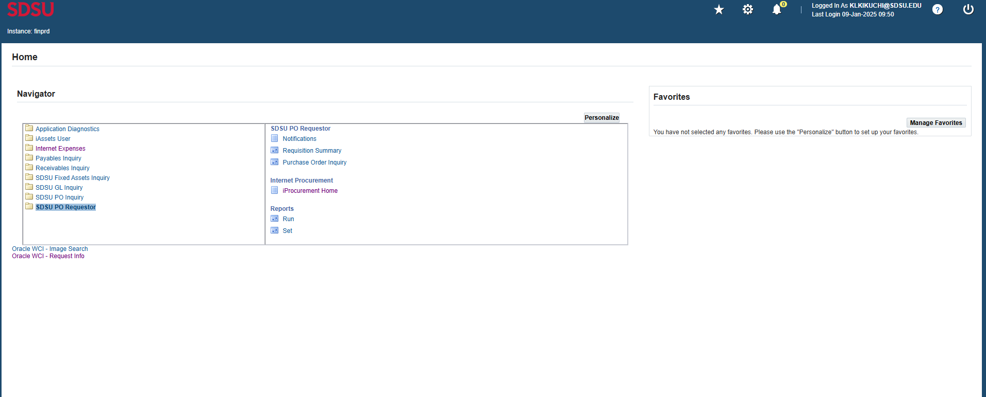
Step 1. Click on “SDSU PO Requestor” then click on “iProcurement Home”.

Slide 6
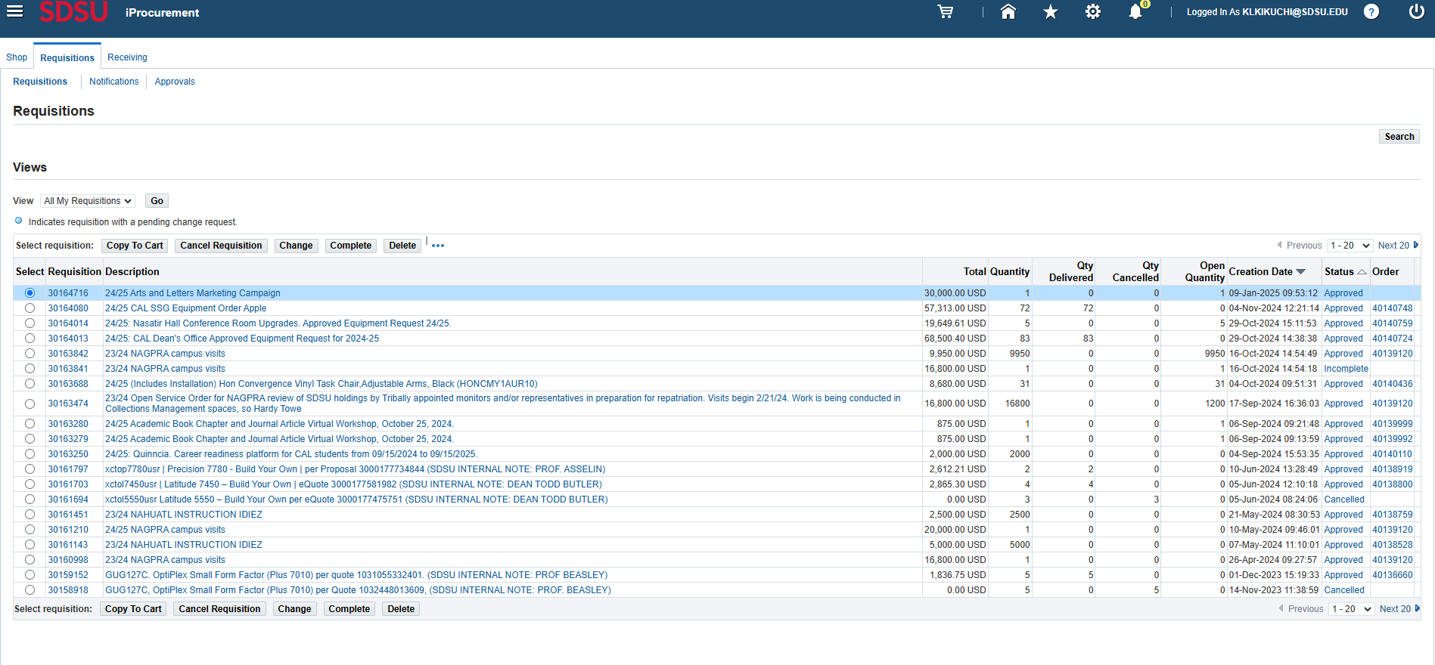
Step 2. Click on the PO number you wish to change to pull up current information.

Slide 7
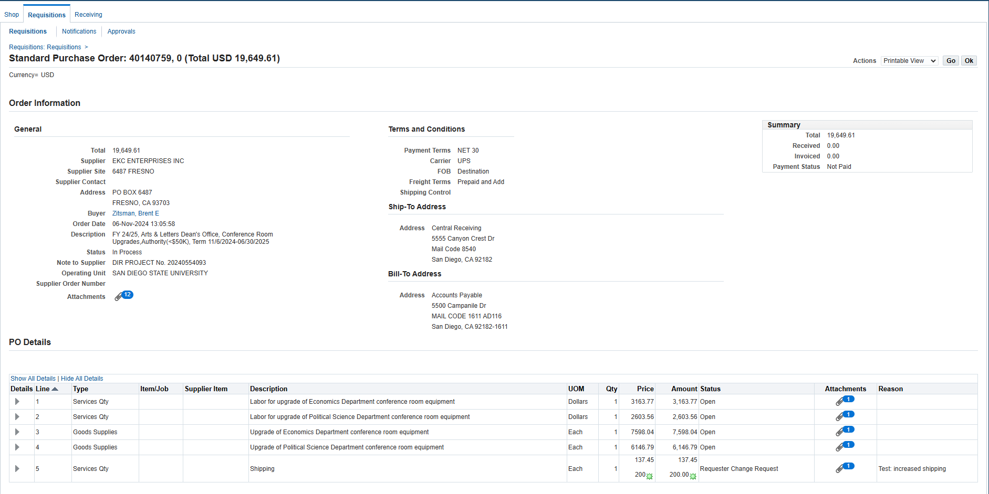
Step 3. This page will provide information on the purchase order you’re trying to change such as the current buyer, number of lines, PO total, etc. Click “Ok” to go back to the page in Step 2.

Slide 8
Step 4. Select the requisition you want to change and click on “change”.

Slide 9
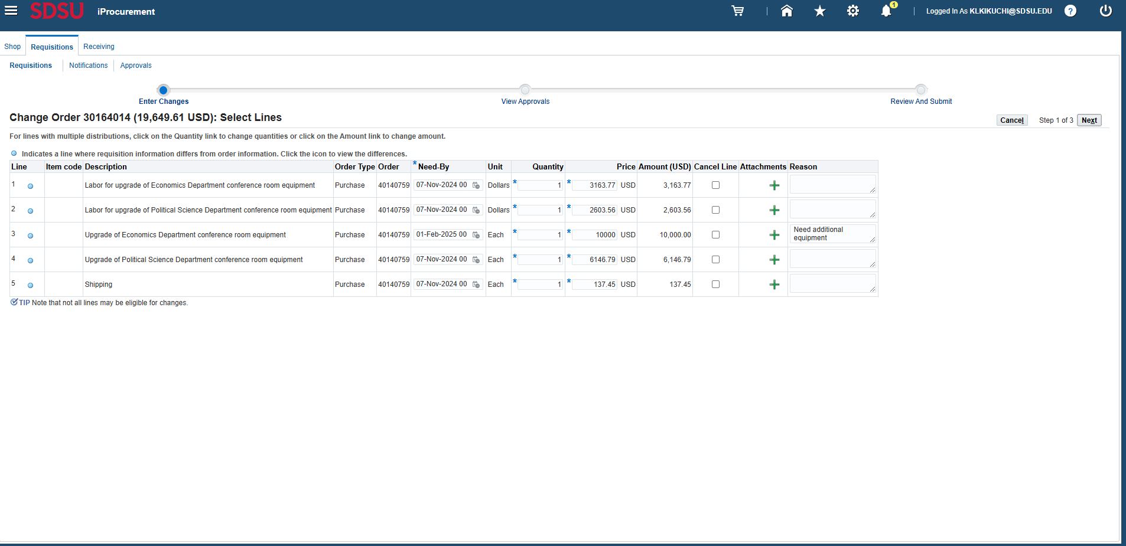
Step 5. Increase or reduce the quantity for quantity-based lines or the price for amount-based lines, be sure to add any relevant attachments the buyer may need, and type in a reason for the change. Be as descriptive as possible. Then click on “next”.

Slide 10
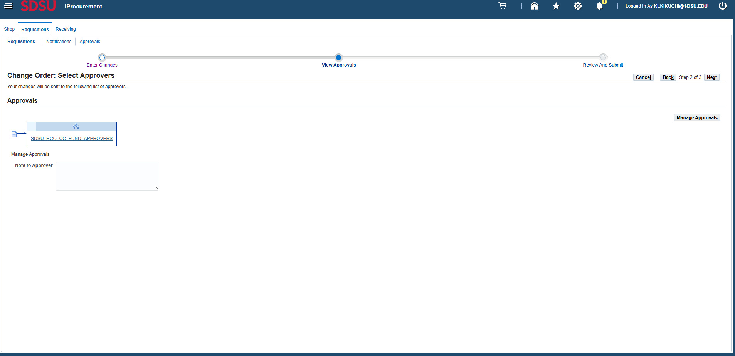
Step 6. Type in a message in “Note to Approver” and click on “Next”. Be as descriptive as possible. The Note to Approver may not always be visible to the approver (the person in the requester’s department who will approve the RCO).

Slide 11
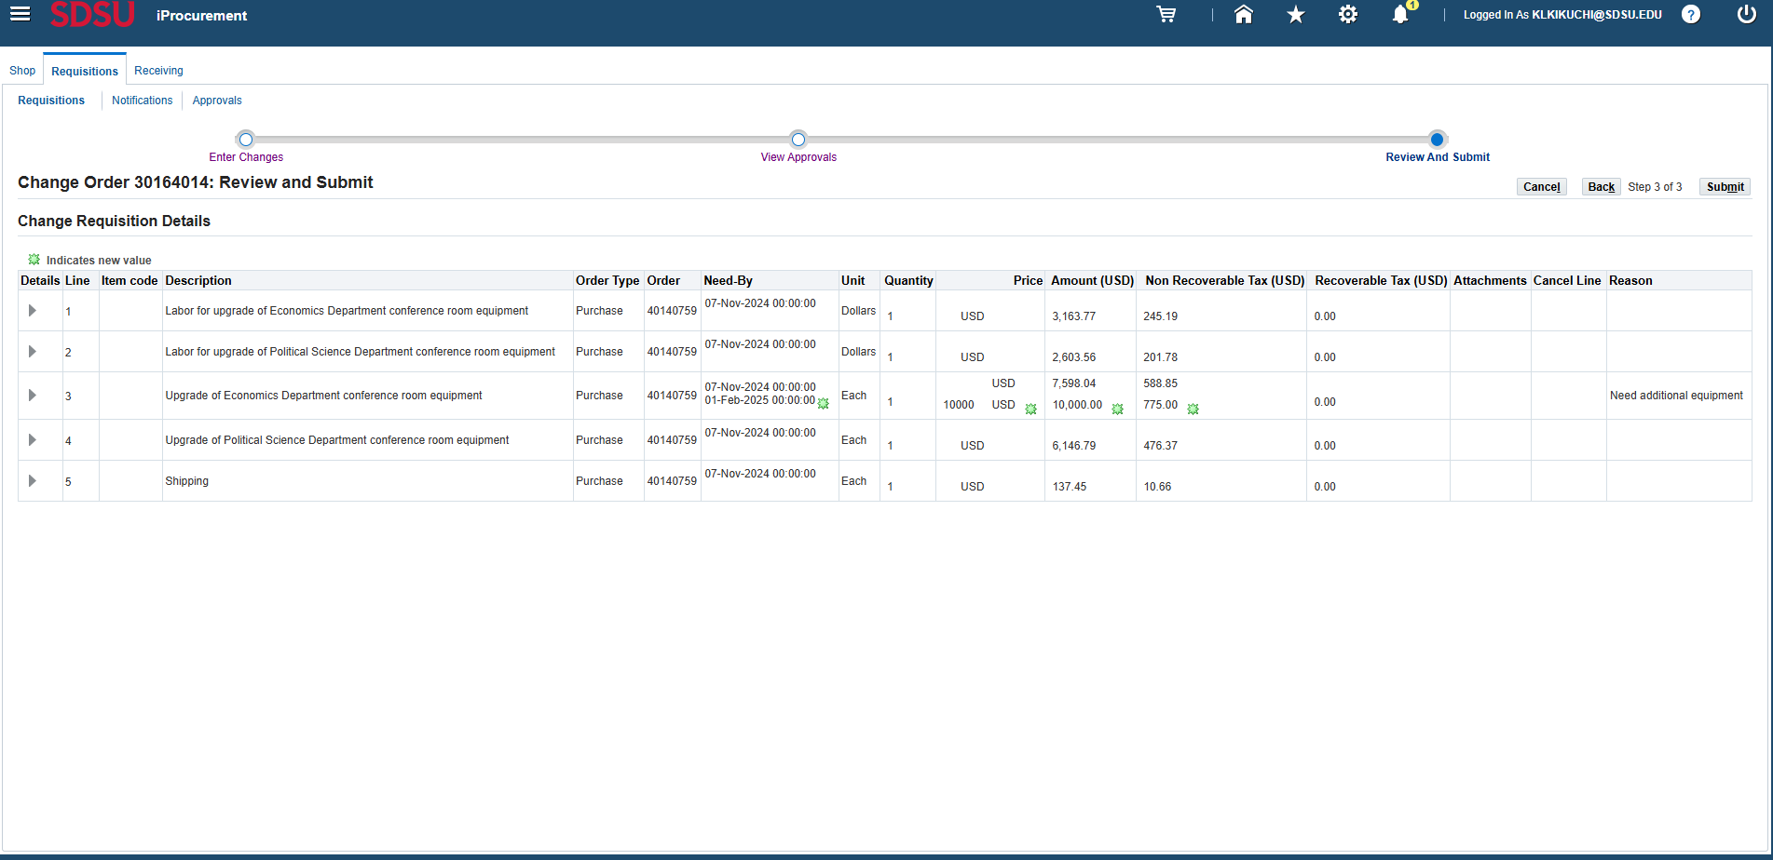
Step 7. The review page will show you which changes are being made to the lines on the requisition. Once you have determined these are the changes you want to make, click on “submit”.

Slide 12
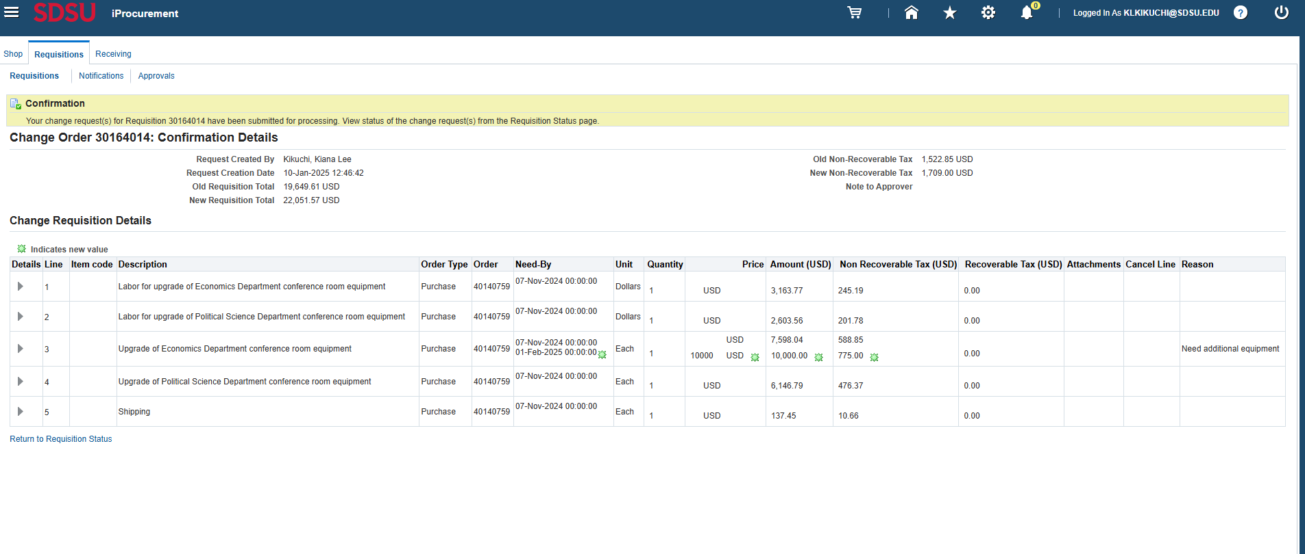
Step 8. You will now see that the RCO has been submitted.

Slide 13
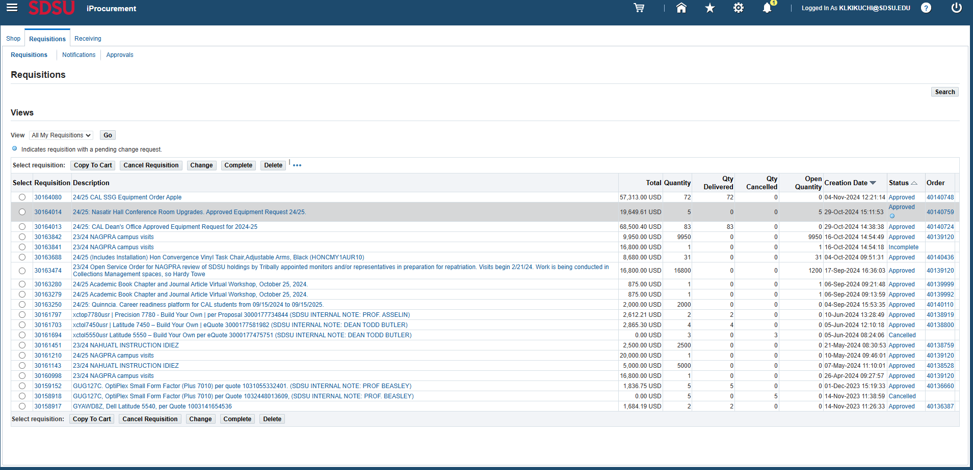
Step 9. You can now see that the RCO is pending approval under “status”. By clicking on “approved”, you can see who it’s currently waiting approval from before it goes to the buyer’s approval.

Slide 14
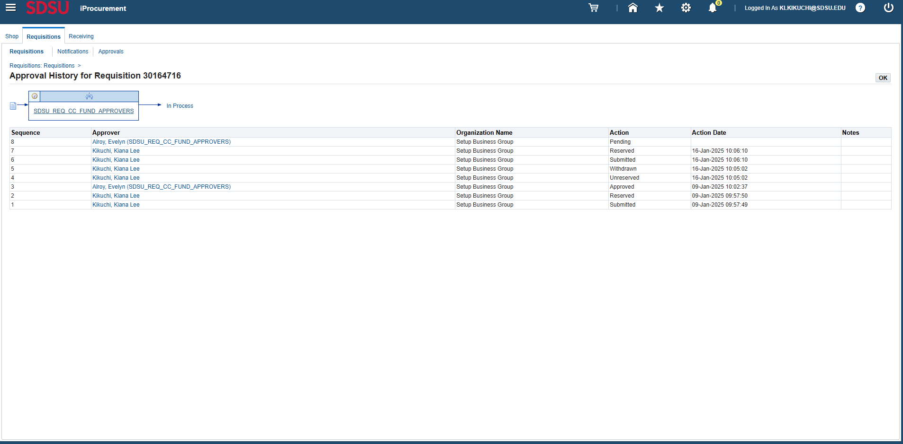
Step 10. You can see who the PO is currently waiting on approval from.

Slide 15
How to cancel funds via RCO

Slide 16
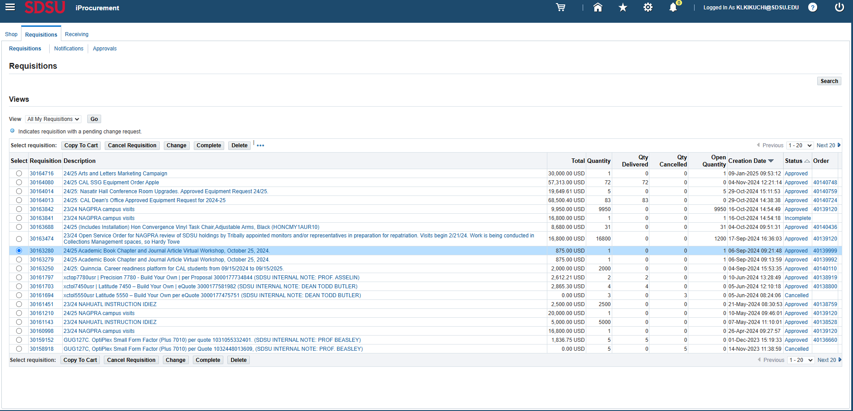
Step 1. To cancel funds, select the requisition you want to change and click on “change”.

Slide 17
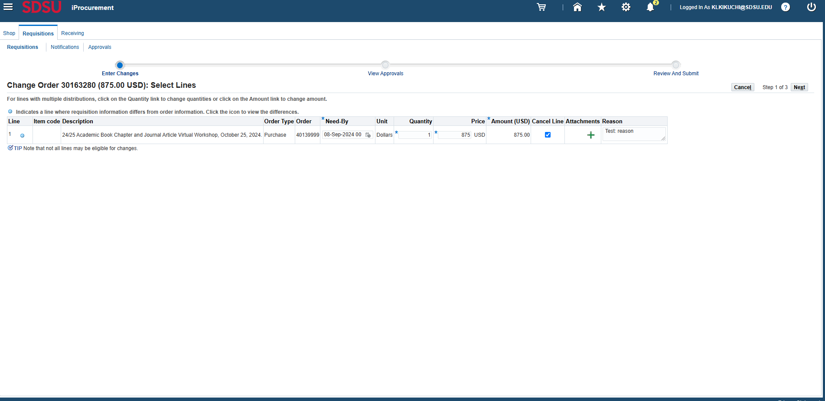
Step 2. Check the box in the “Cancel Line” column, be sure to add any relevant attachments the buyer may need, and type in a reason for the change. Be as descriptive as possible. Then click on “next”.

Slide 18
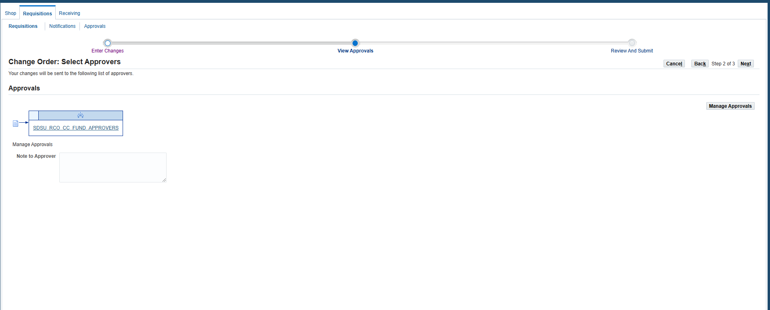
Step 3. Type in a message in “Note to Approver” and click on “Next”. Be as descriptive as possible. The Note to Approver may not always be visible to the approver (the person in the requester’s department who will approve the RCO).

Slide 19
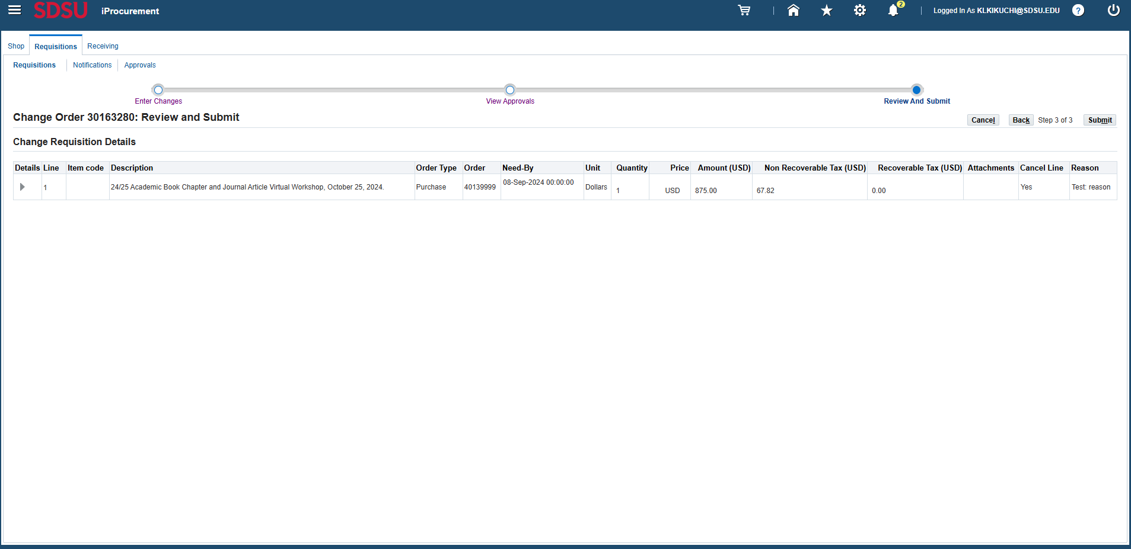
Step 4. The review page will show you which changes are being made to the lines on the requisition. Once you have determined these are the changes you want to make, click on “submit”.

Slide 20
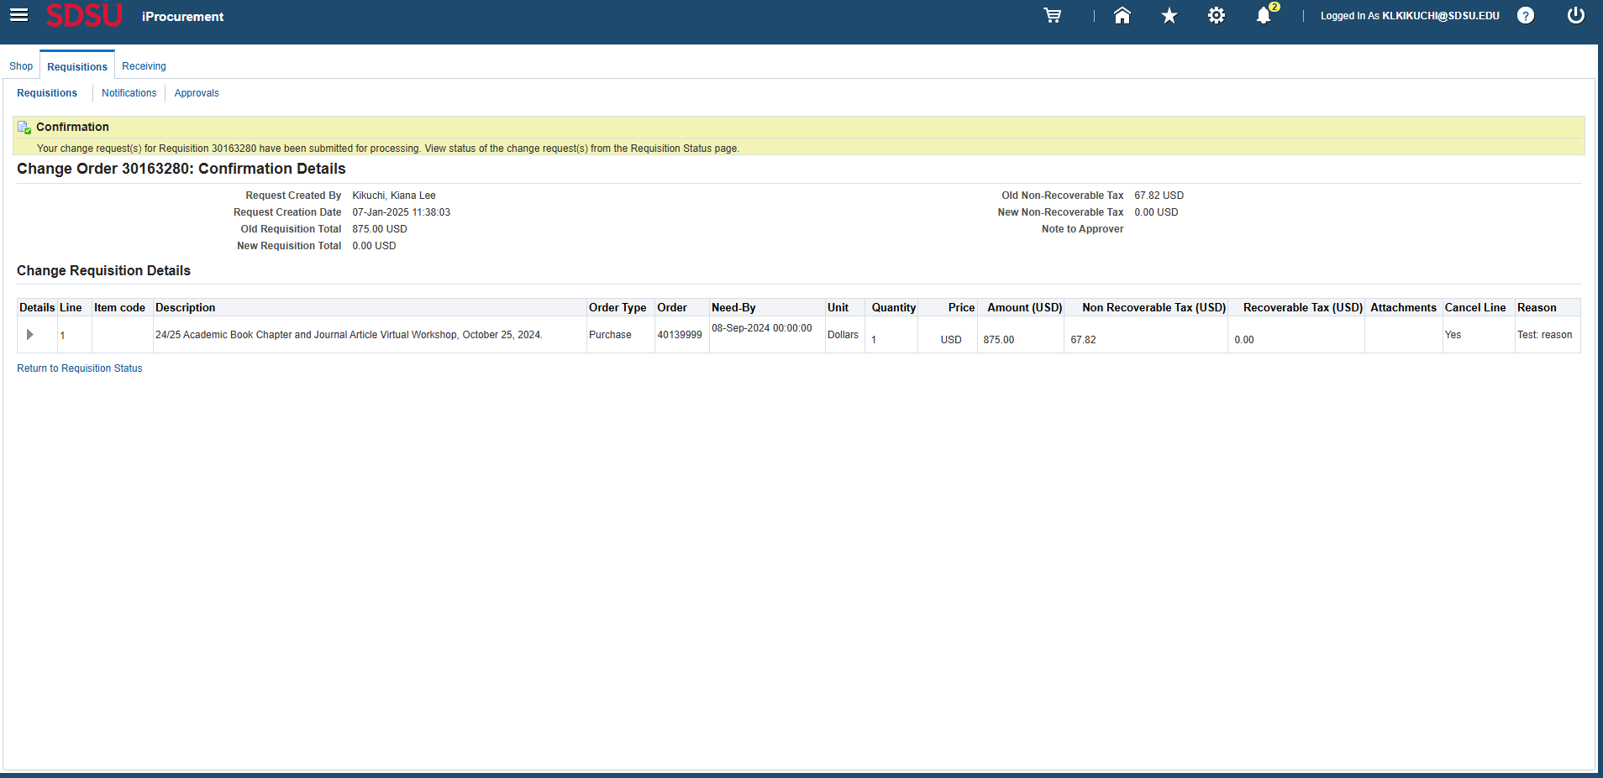
Step 5. You will now see that the RCO has been submitted.

Slide 21
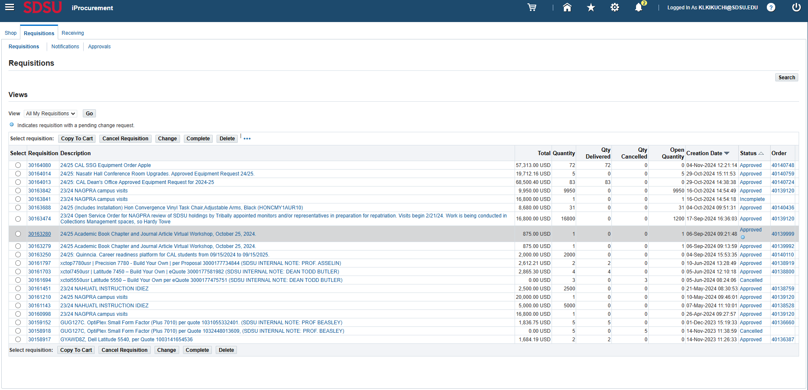
Step 6. You can now see that the RCO is pending approval under “status”. By clicking on “approved”, you can see who it’s currently waiting approval from before it goes to the buyer’s approval.

Slide 22
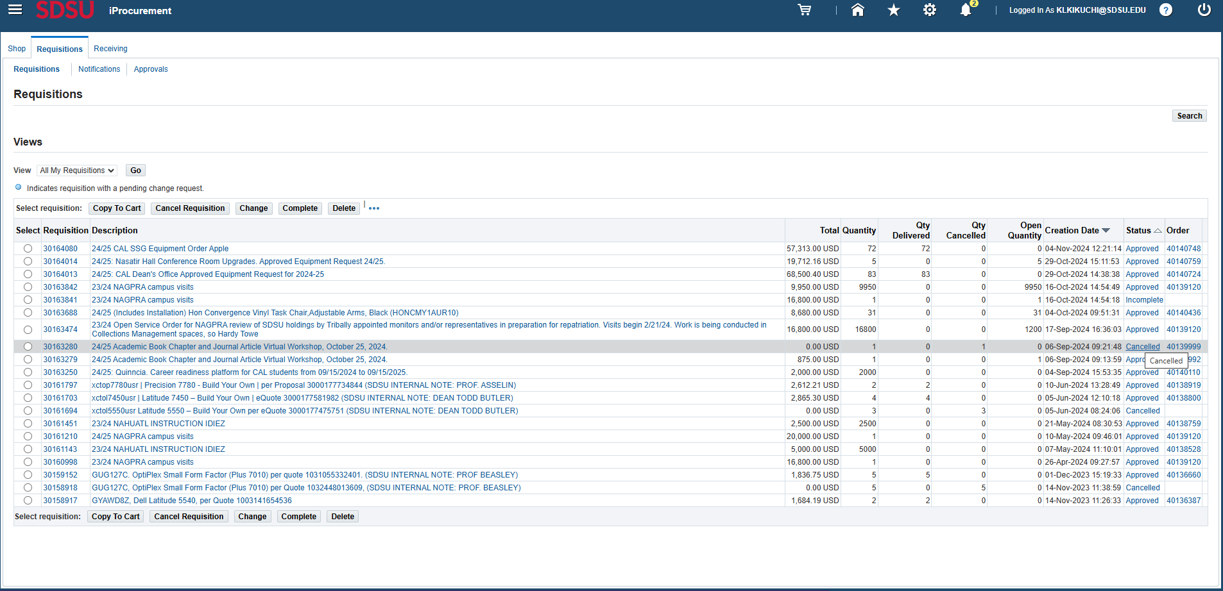
Step 7. Once the RCO is approved by the buyer, the line will show as closed. In the below example, the status shows as “Cancelled” because there was only one line on the PO.

Slide 23
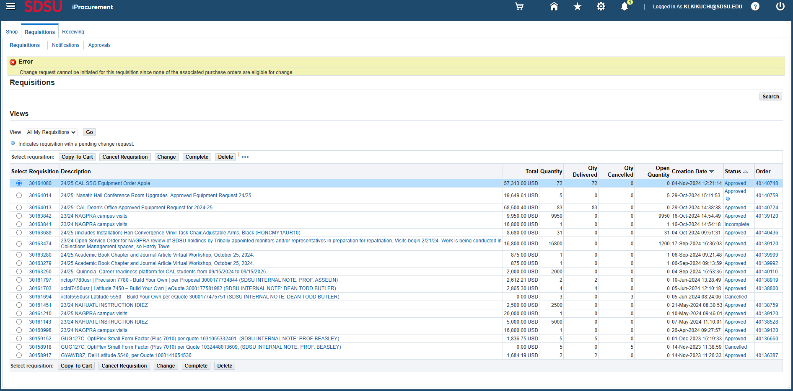
Step 8. Note that there are instances where an RCO can’t be submitted for a PO. Has the PO line(s) been received in full by Central Receiving? Has the line(s) been billed in full? Is the buyer inactive? In these cases, reach out to the buyer for a resolution.

Slide 24
Question? Contact p2pcampuscare@sdsu.edu
Website: https://procuretopay.sdsu.edu

