Slide 1
How to Create a
Requisition
Procure to Pay
P2PCampusCare@sdsu.edu
https://procuretopay.sdsu.edu/
https://sdsuedu.sharepoint.com/sites/procuretopay

Slide 2
Step 1 Login to Oracle at https://aisfinprd.sdsu.edu:4443
(a) Click on SDSU PO Requestor
(b) Click on iProcurement Home

Slide 3
Step 2
Stay in the Shop tab & click on the Non-Catalog Request subsection

Slide 4
Step 3
Fill in the information for all required fields
Notes:
Click on the magnifying glass icon to search database
Regarding supplier information, please search the supplier’s name in the database first (click on the magnifying glass icon next to the Supplier Name box; if supplier is not found in database, then click “New Supplier” box and enter the information).
Again, check the “New Supplier” box ONLY if the supplier is truly new to SDSU

Slide 5
Please select the appropriate choice
Drop-down menu for Item Type has 3 options:
Goods – item price & quantity
Services – rate & quantity
Goods or Services – description & total amount

Slide 6
Amount Based
22/23 HS 650 PERFORMANCE AUTOMATION SOLUTIONS INC TO PROVIDE BUILDING AUTOMATION SYSTEM SERVICES FOR HOUSING JULY 2022 THROUGH JUNE 2023
PERFORMANCE AUTOMATION SOLUTIONS INC
SERVICE MAINT MISC
$5,640
JOHN DOE
123-456-7890
SERVICE AMOUNT

Slide 7
Quantity Based - Goods
22/23 HS-650 HUBBELL WIRING DEVICE-KELLEMS LOCKING CONNECTOR Item 3D258 Mfr. Model HBL7506C
ELECTRICAL SUPPLIES
300
EACH
$42.23
GOODS/SUPPLIES

Slide 8
Quantity Based - Services
22-23 ABC CONSULTING SERVICES
SERVICE CONSULTING
HOUR
10
$350
SERVICES QTY

Slide 9
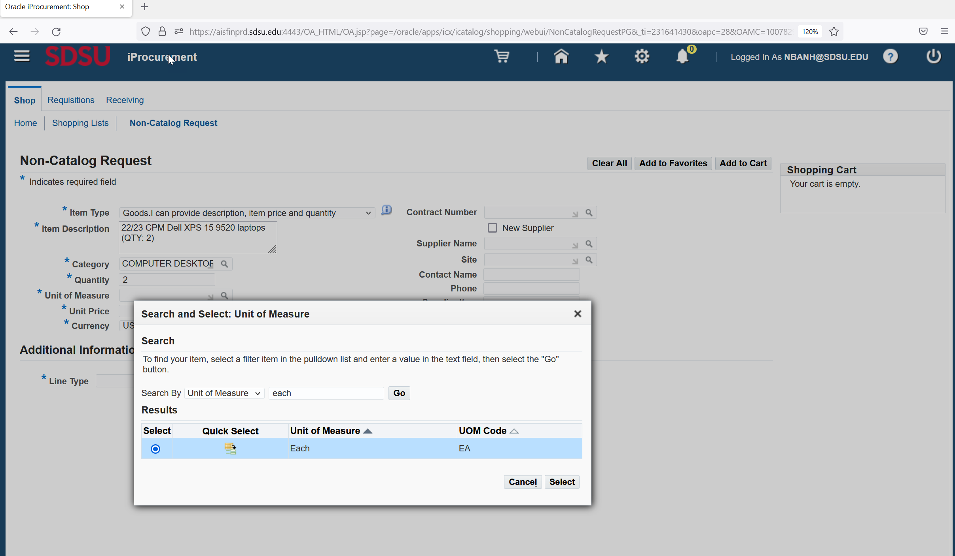
Search function – Magnifying glass icon
When you click on the magnifying glass icon, a window pops up. You may enter a keyword in the search box and then click “Go”
Or, if you want to see a listing of all the options, then leave the search box blank and just click “Go”

Slide 10
Step 4
Once all the information is entered, click “Add to Cart”

Slide 11
Step 5
(a) Repeat step 3 & 4 for each line entry if requisition is itemized as seen on your quote
(b) When all lines are entered, click “View Cart and Checkout” button. A window will pop-up (see next slide)
*Note: You do not need to add a line for taxes.
**Note: You need to add EWRFs (electronic waste recycling fees)
***Note: You need to add a freight line if it is > $500.

Slide 12
Step 6
Click Edit

Slide 13
Step 7 Review & Edit Account String
(a) Click on the checkbox
(b) Click on the Update button

Slide 14
Opportunity to Revise & Add Information
Review all the information you’ve entered to ensure accuracy and edit as needed. You may also add a “Note To Buyer”.
Please ensure that the account string is correct, and if necessary, update it.

Slide 15
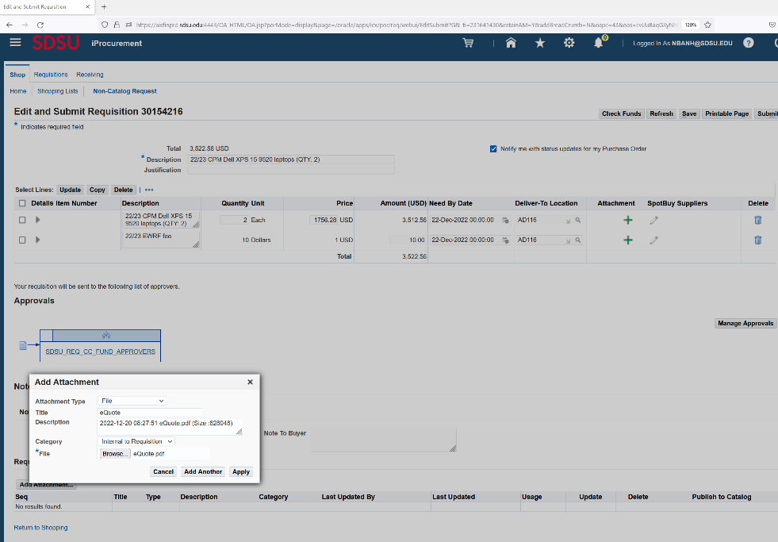
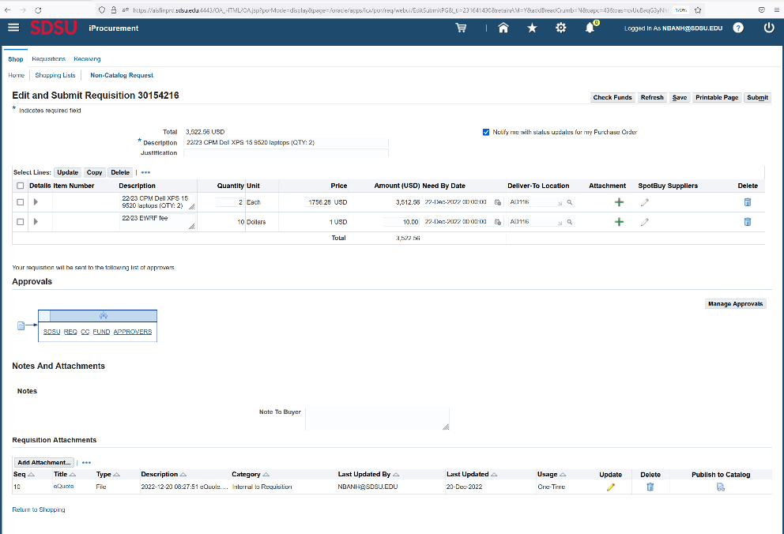
Step 8
Click Add Attachment to attach your documents (e.g., Quote, TARP, proposal or contract received from vendor).
Keep attachment type as “File,” give each a name, and click Browse to select the document you want to attach.
If you have multiple documents to attach, click Add Another after each document until the last attachment. After the last attachment, click Apply
Note: Once the document(s) is successfully attached, it would be displayed under the Add Attachment section as seen here

Slide 16
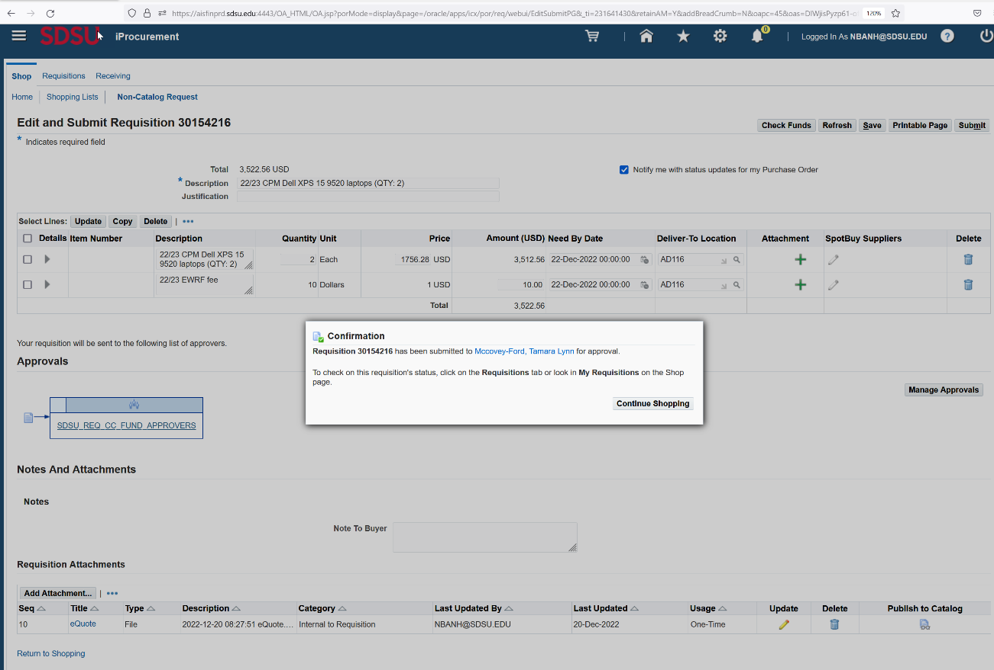
Step 9
Click Submit
Record the requisition number for your records

Slide 17
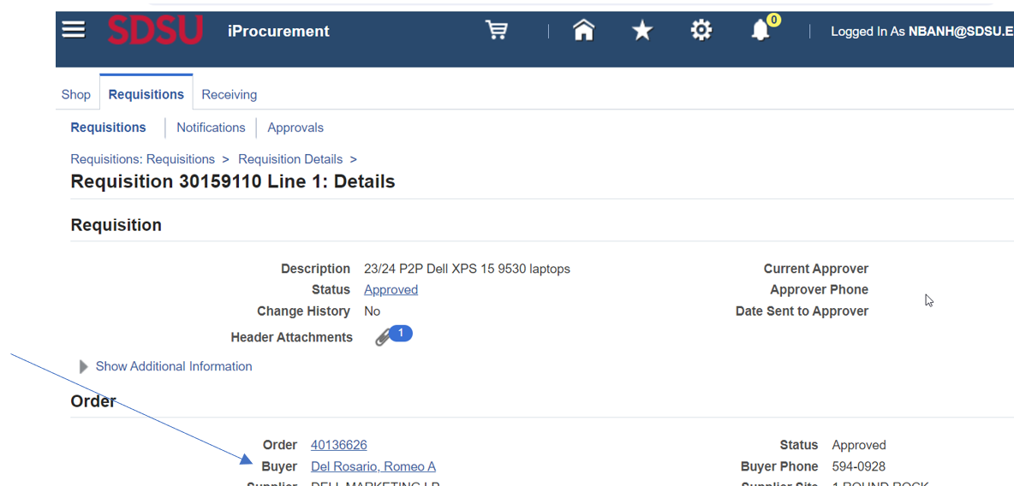
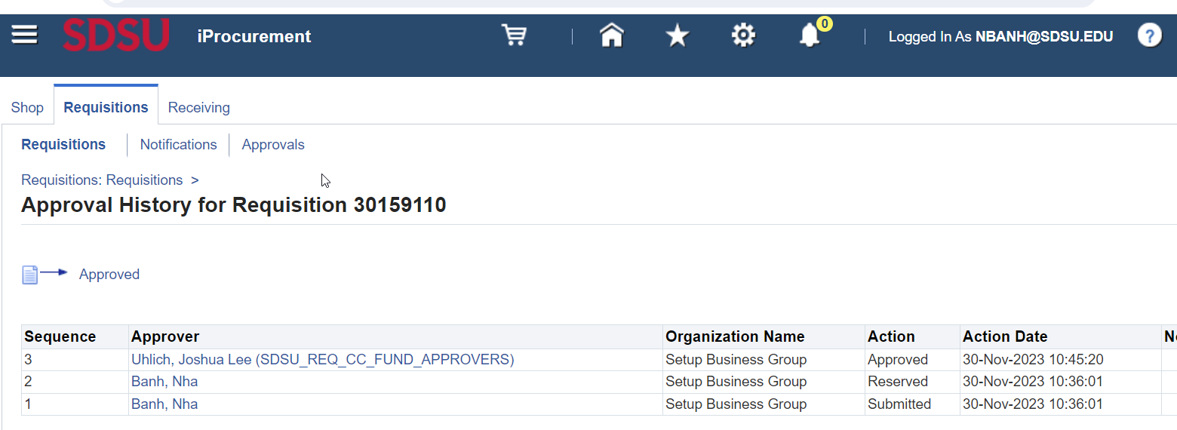
How to look-up…
Requisition Status
SDSU PO Requestor 🡪 iProcurement Home 🡪 Requisition 🡪 Status
Assigned Buyer
SDSU PO Requestor 🡪 iProcurement Home 🡪 Requisition 🡪 Details

Slide 18
Additional Notes
In general, when a PO is created, matching type is set-up as a 3-way verification for purchase of goods and 2-way for procurement of services.
The 3-way verification process involves Logistical Services, specifically Shipping and Receiving. In this case, the department would need to inform Shipping & Receiving Services Lead (Mike Johnson, mjohnson@sdsu.edu) when the department receives all the items ordered. Invoice is paid only after both the department requisitioner and Shipping & Receiving Services Lead approve the release of payment.
All goods should come to campus through SDSU Central Receiving for proper receipting: SDSU Central Receiving, 5555 Canyon Crest Dr., San Diego, CA 92182.
Invoices related to PO are to be submitted through the ingestion email at to sdsuapinv@sdsu.edu

Slide 19
Additional Notes (cont.)
Dual Period: Mid-May to mid-June (date varies from year to year, please refer to the campus year-end deadlines notification for exact dates)
Requisition submission for both current & next fiscal year
GL date must be changed to July 1st for requisitions that are meant for the next fiscal year

Slide 20
Thank You
Questions
p2pCampusCare@sdsu.edu
https://procuretopay.sdsu.edu/
https://sdsuedu.sharepoint.com/sites/procuretopay

